Slide 1
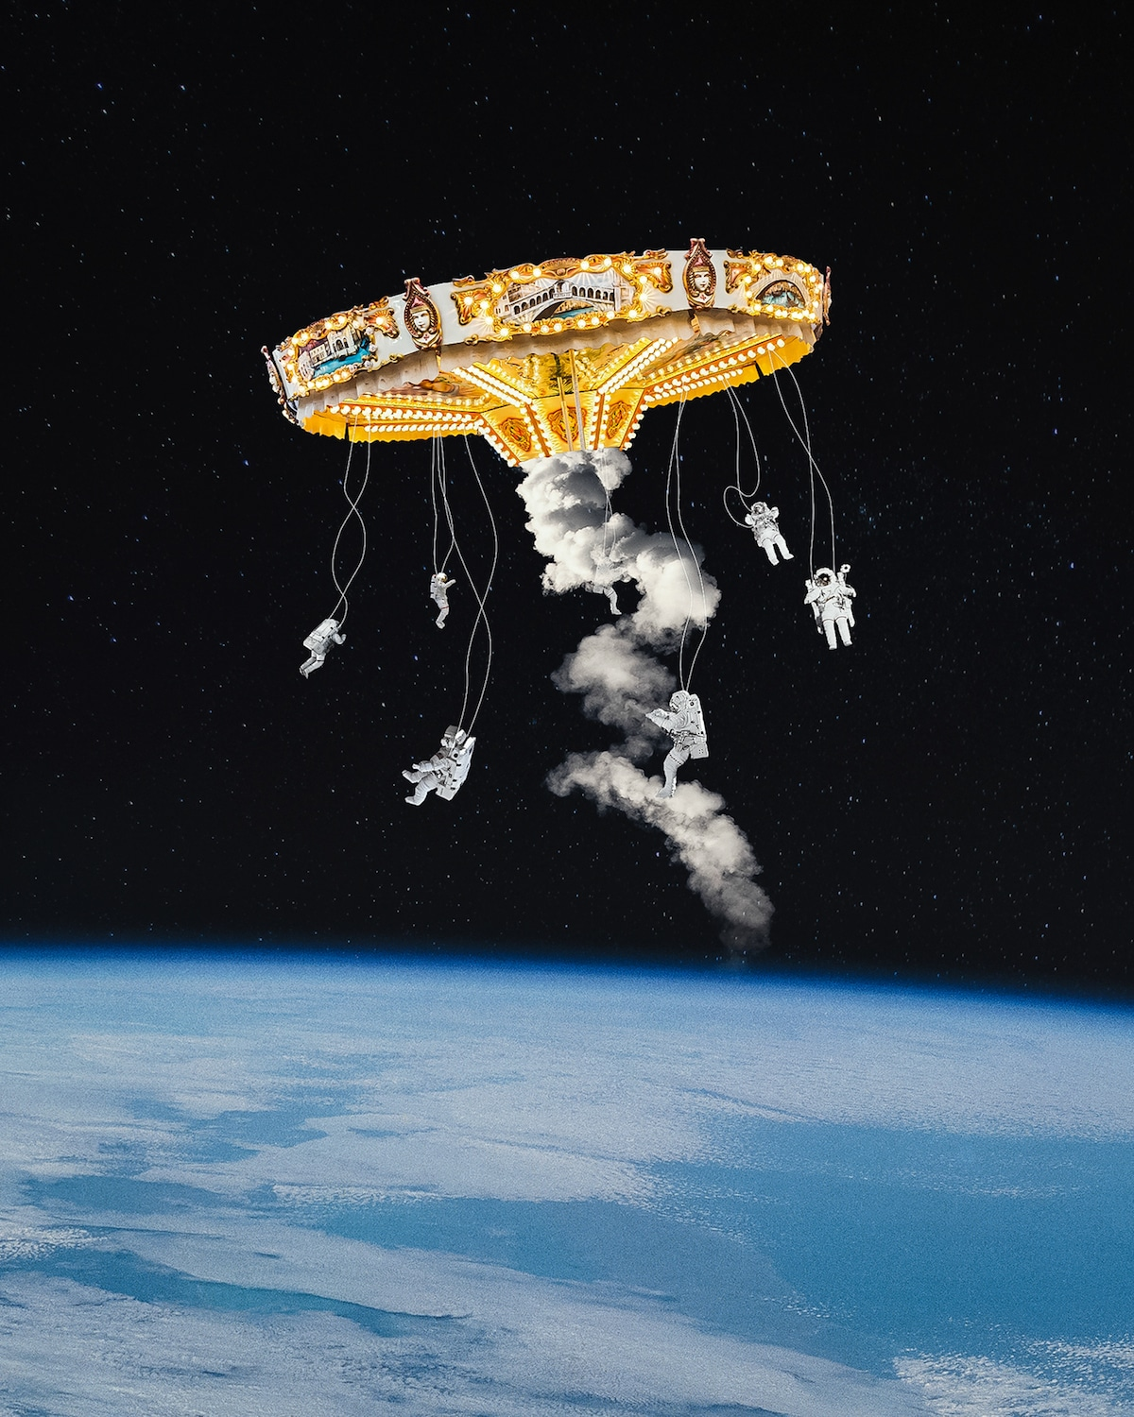
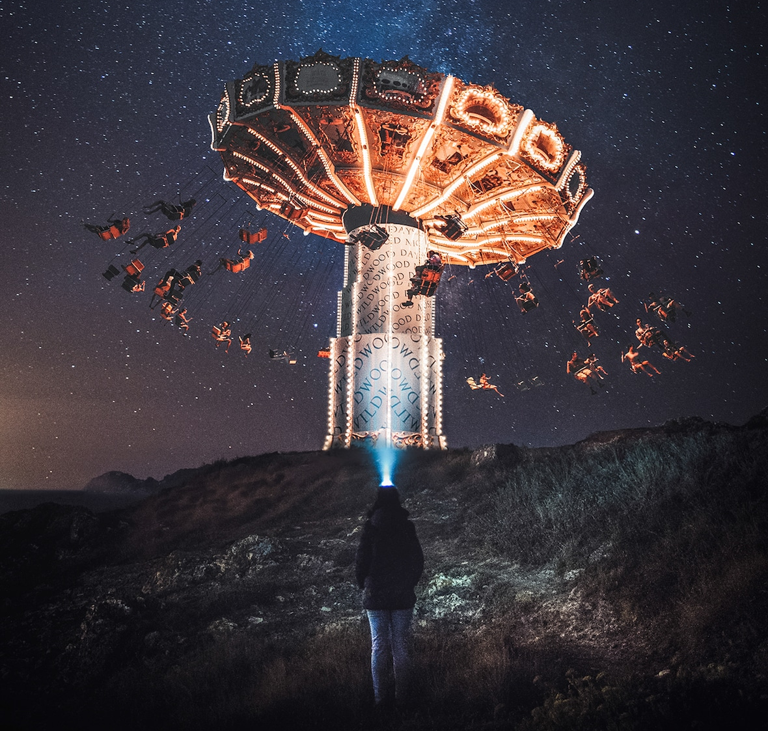
SurRealiSm Collages

Slide 2
What is Surrealism?
Surrealism was a cultural movement which developed in Europe in the aftermath of World War I.
Surrealistic art is characterized by dream-like visuals, the use of symbolism, and collage images.

Slide 3
Characteristics of Surrealism
Juxtaposition - is the placement of two or more things side by side, often in order to bring out their differences.
Humor
Scale - variation of sizes
Chaos
Fantasy
Irrationality - doesn’t make sense
Dreams
Fears
Symbols

Slide 4
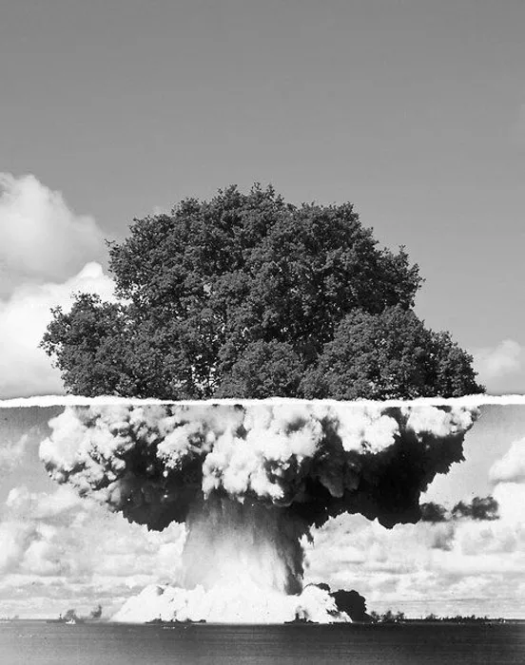
Juxtaposition:
A tree-natural and growing
An atomic explosion- destructive, reaction of humanity

Slide 5
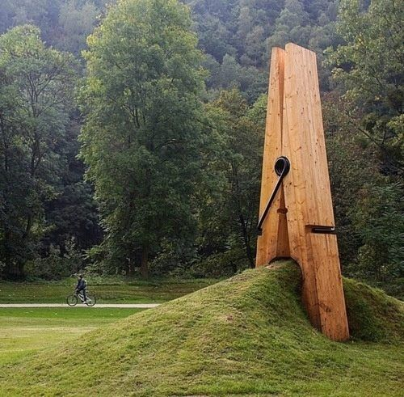
Scale:
Scale refers to the size of an object (a whole) in relationship to another object (another whole).
The clothes pin (usually small) has been enlarged to change the appearance of the land, making it look smaller.

Slide 6
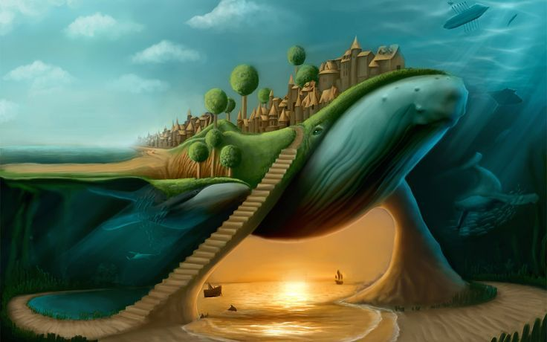
Irrationality:
A city on top of a whale
Underwater or above land?
Beach underwater?
It doesn’t make sense!

Slide 7
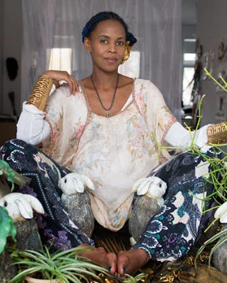
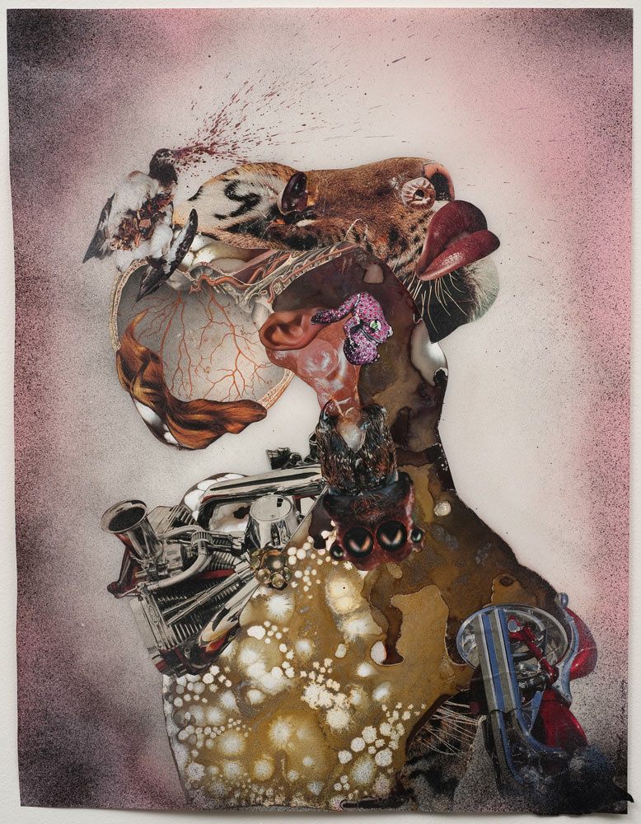
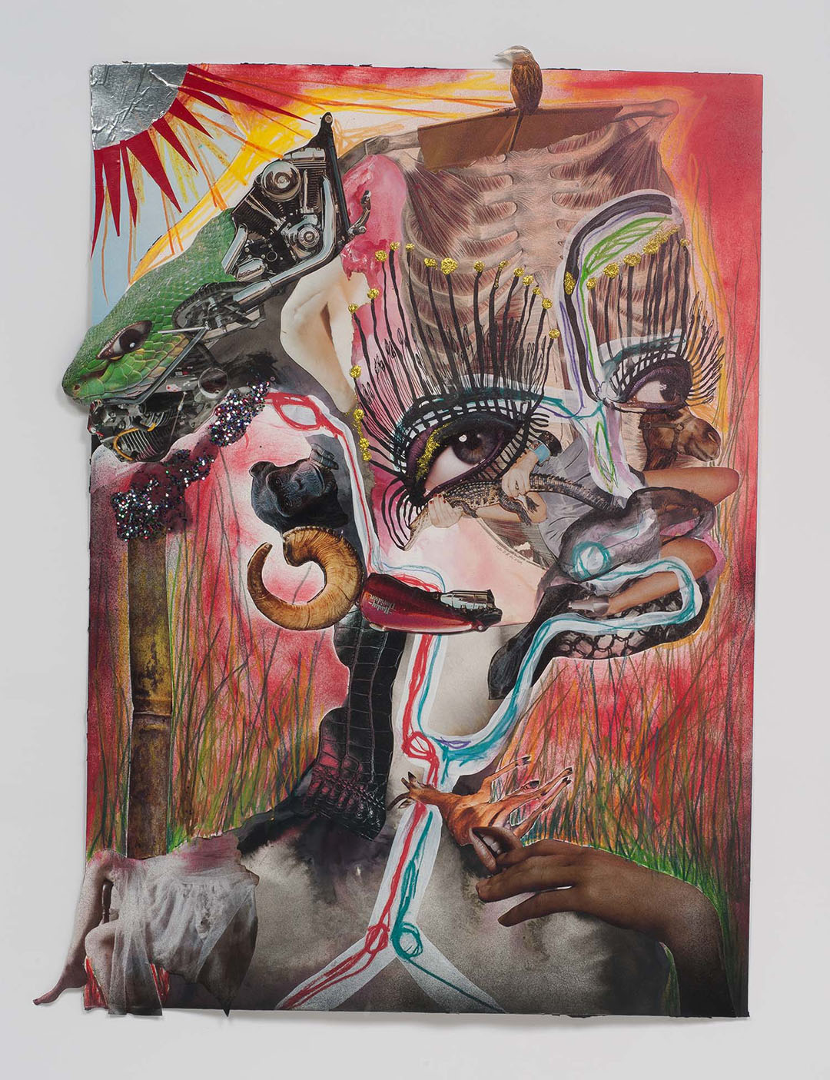
Wangechi Mutu

Slide 8
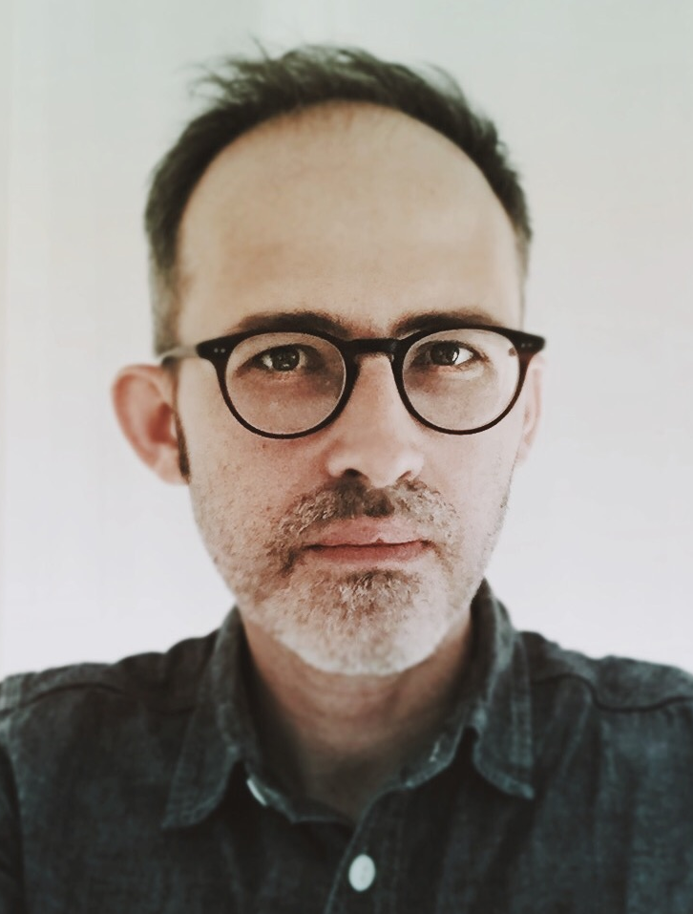
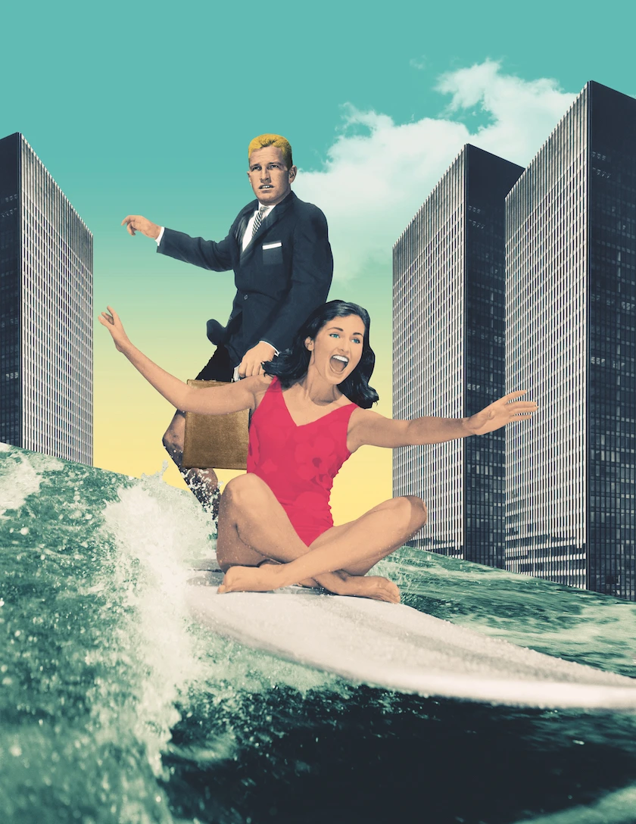
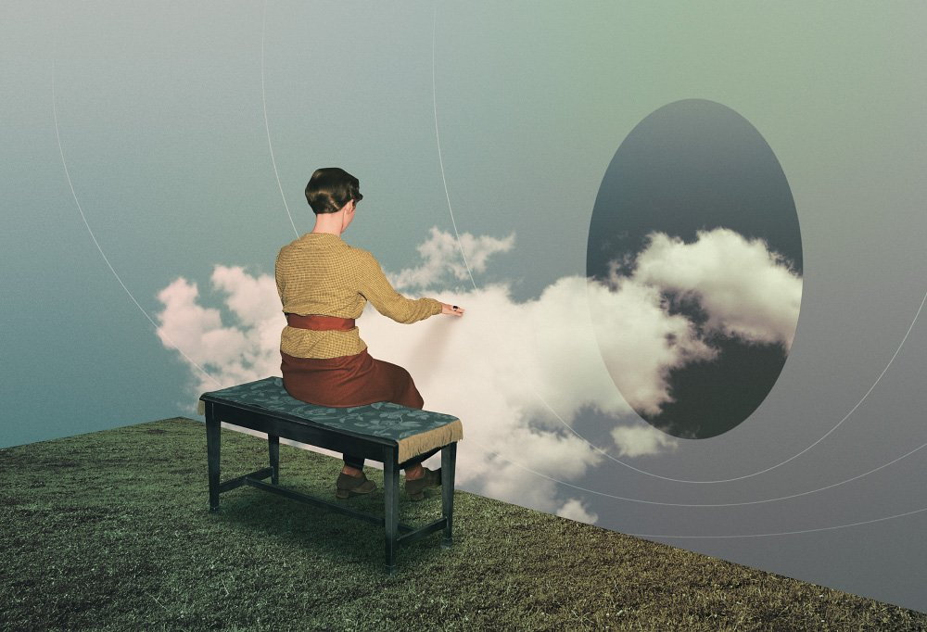
Julien Pacaud

Slide 9
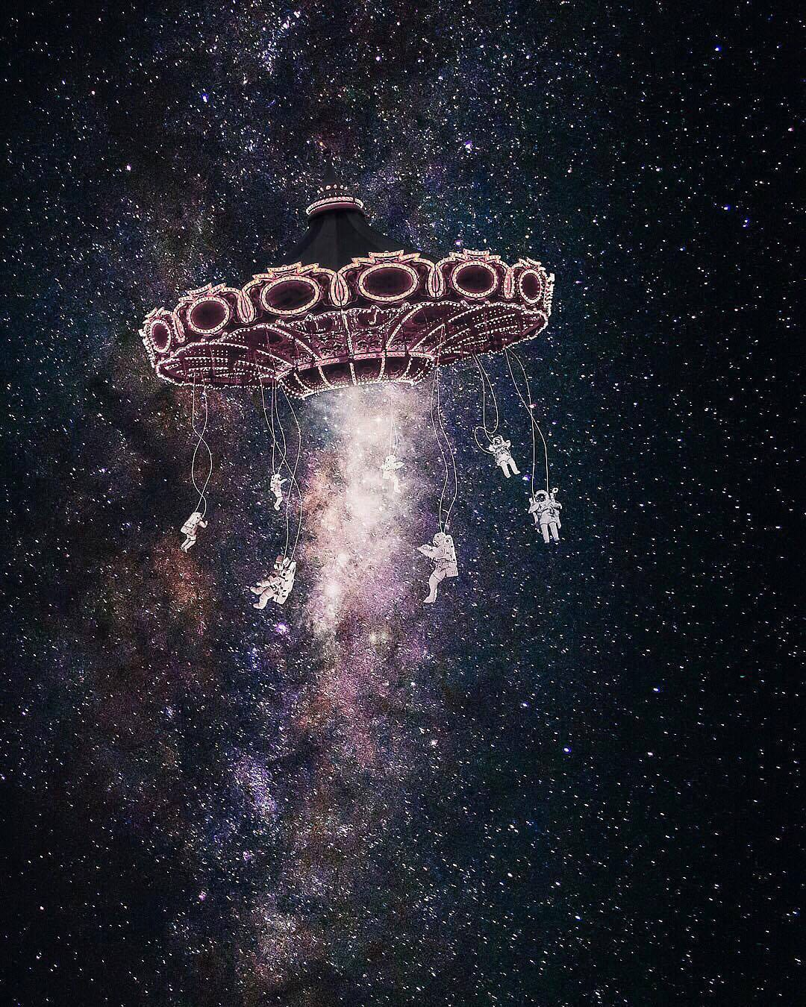
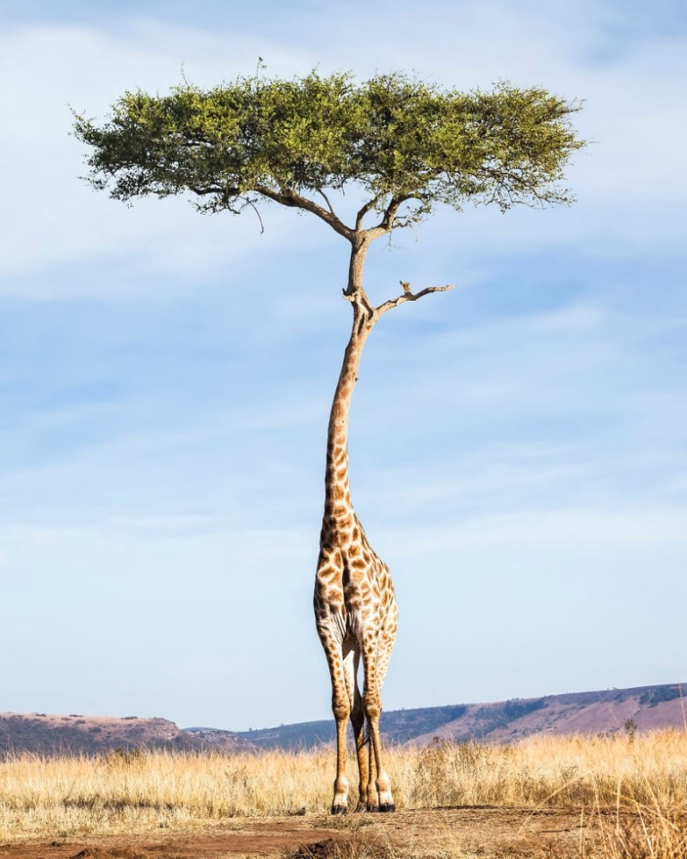
Justin Peters

Slide 10
Create your own Surrealism Collage!
Materials: magazines, colorful paper, newspaper, sheet music, photographs, pages of old books, scissors, glue, xacto knife (if you have one), scrap paper, stamps, old drawing/painting cutouts etc.
Goal: Create a surrealist collage using the materials listed. You must use at least three different material sources (ex. Magazine, newspaper, photographs). Think about hate characteristics of surrealism. Do you want to incorporate humor? Maybe scale or irrationality?
Note: Images/ text used must be school appropriate!

