Slide 1
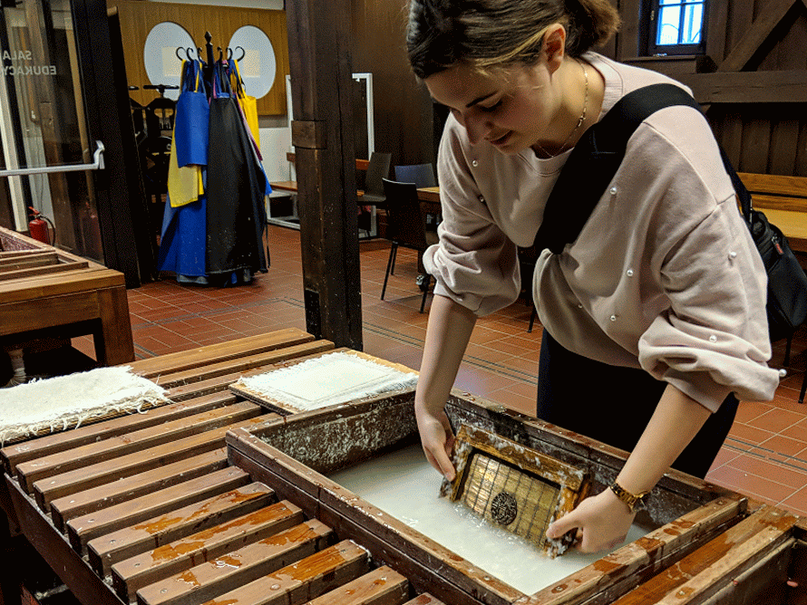
The History of Papermaking

Slide 2
Objectives
We will discover the history of making paper.
We will experiment with two techniques of paper making; both traditional techniques, and modern.
  The traditional method will be used for a future project with your history teacher.
  Using the modern method, we will attempt to create “paintings” using paper pulp.

Slide 3
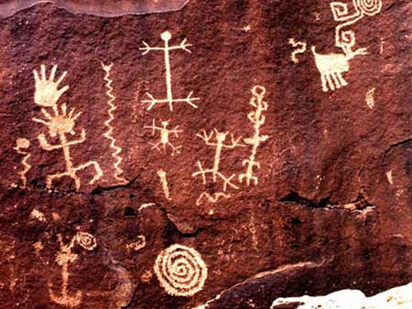
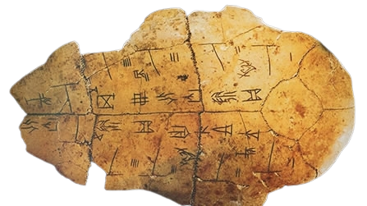
Did you know?!
The history of making paper dates back to over 2000 years!
  Before paper, people communicated through pictures and symbols etched on stone, bones, cave walls, or clay tablets.

Slide 4
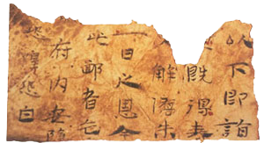
Who?
Paper as we know it today was first made in Lei-Yang, China.
  mixed mulberry bark, hemp leaves and rags with water, mashed it into pulp, pressed out the liquid, and hung the thin mat to dry in the sun.

Slide 5
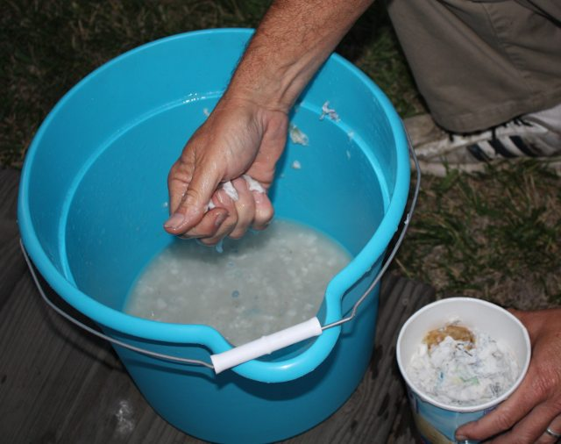
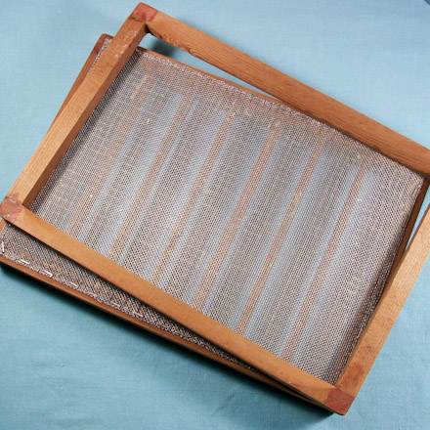
What?
Pulp
Deckle

Slide 6
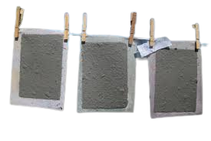
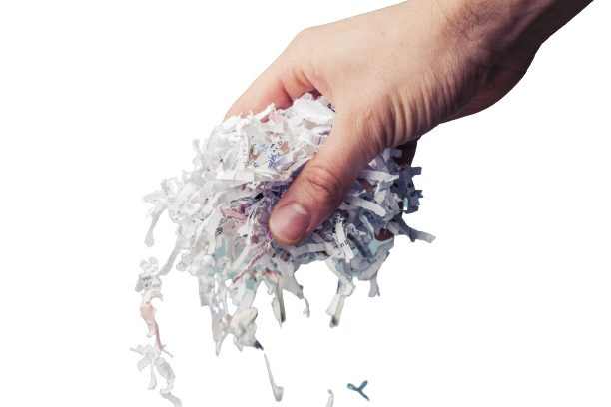
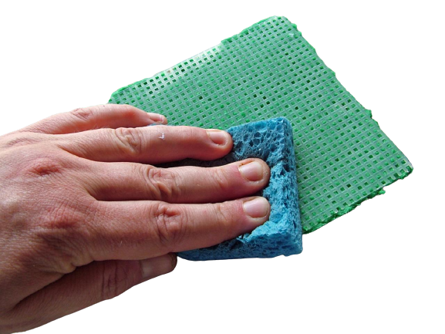
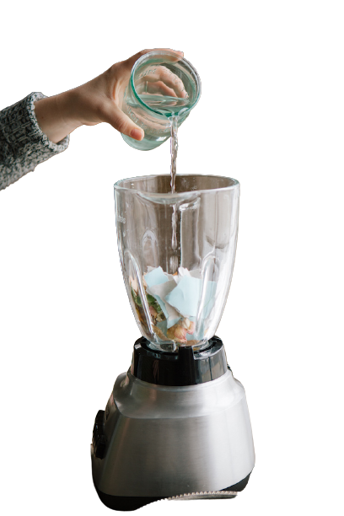
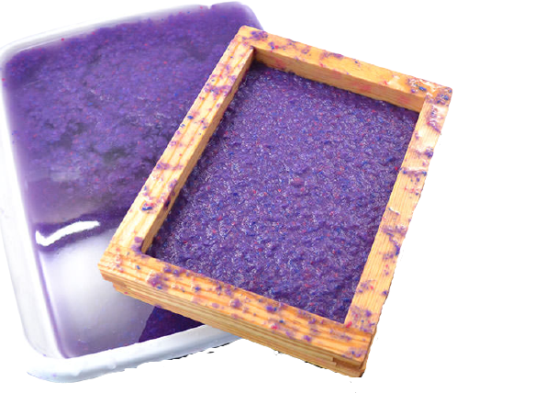
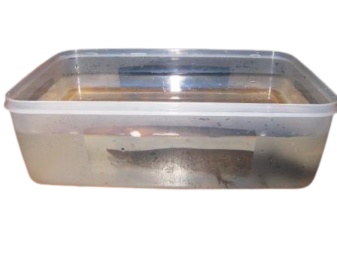
STEP 1
STEP 6
STEP 5
Traditional Paper Making
Vs
Modern Paper Making
STEP 4
STEP 2
STEP 3

Slide 7
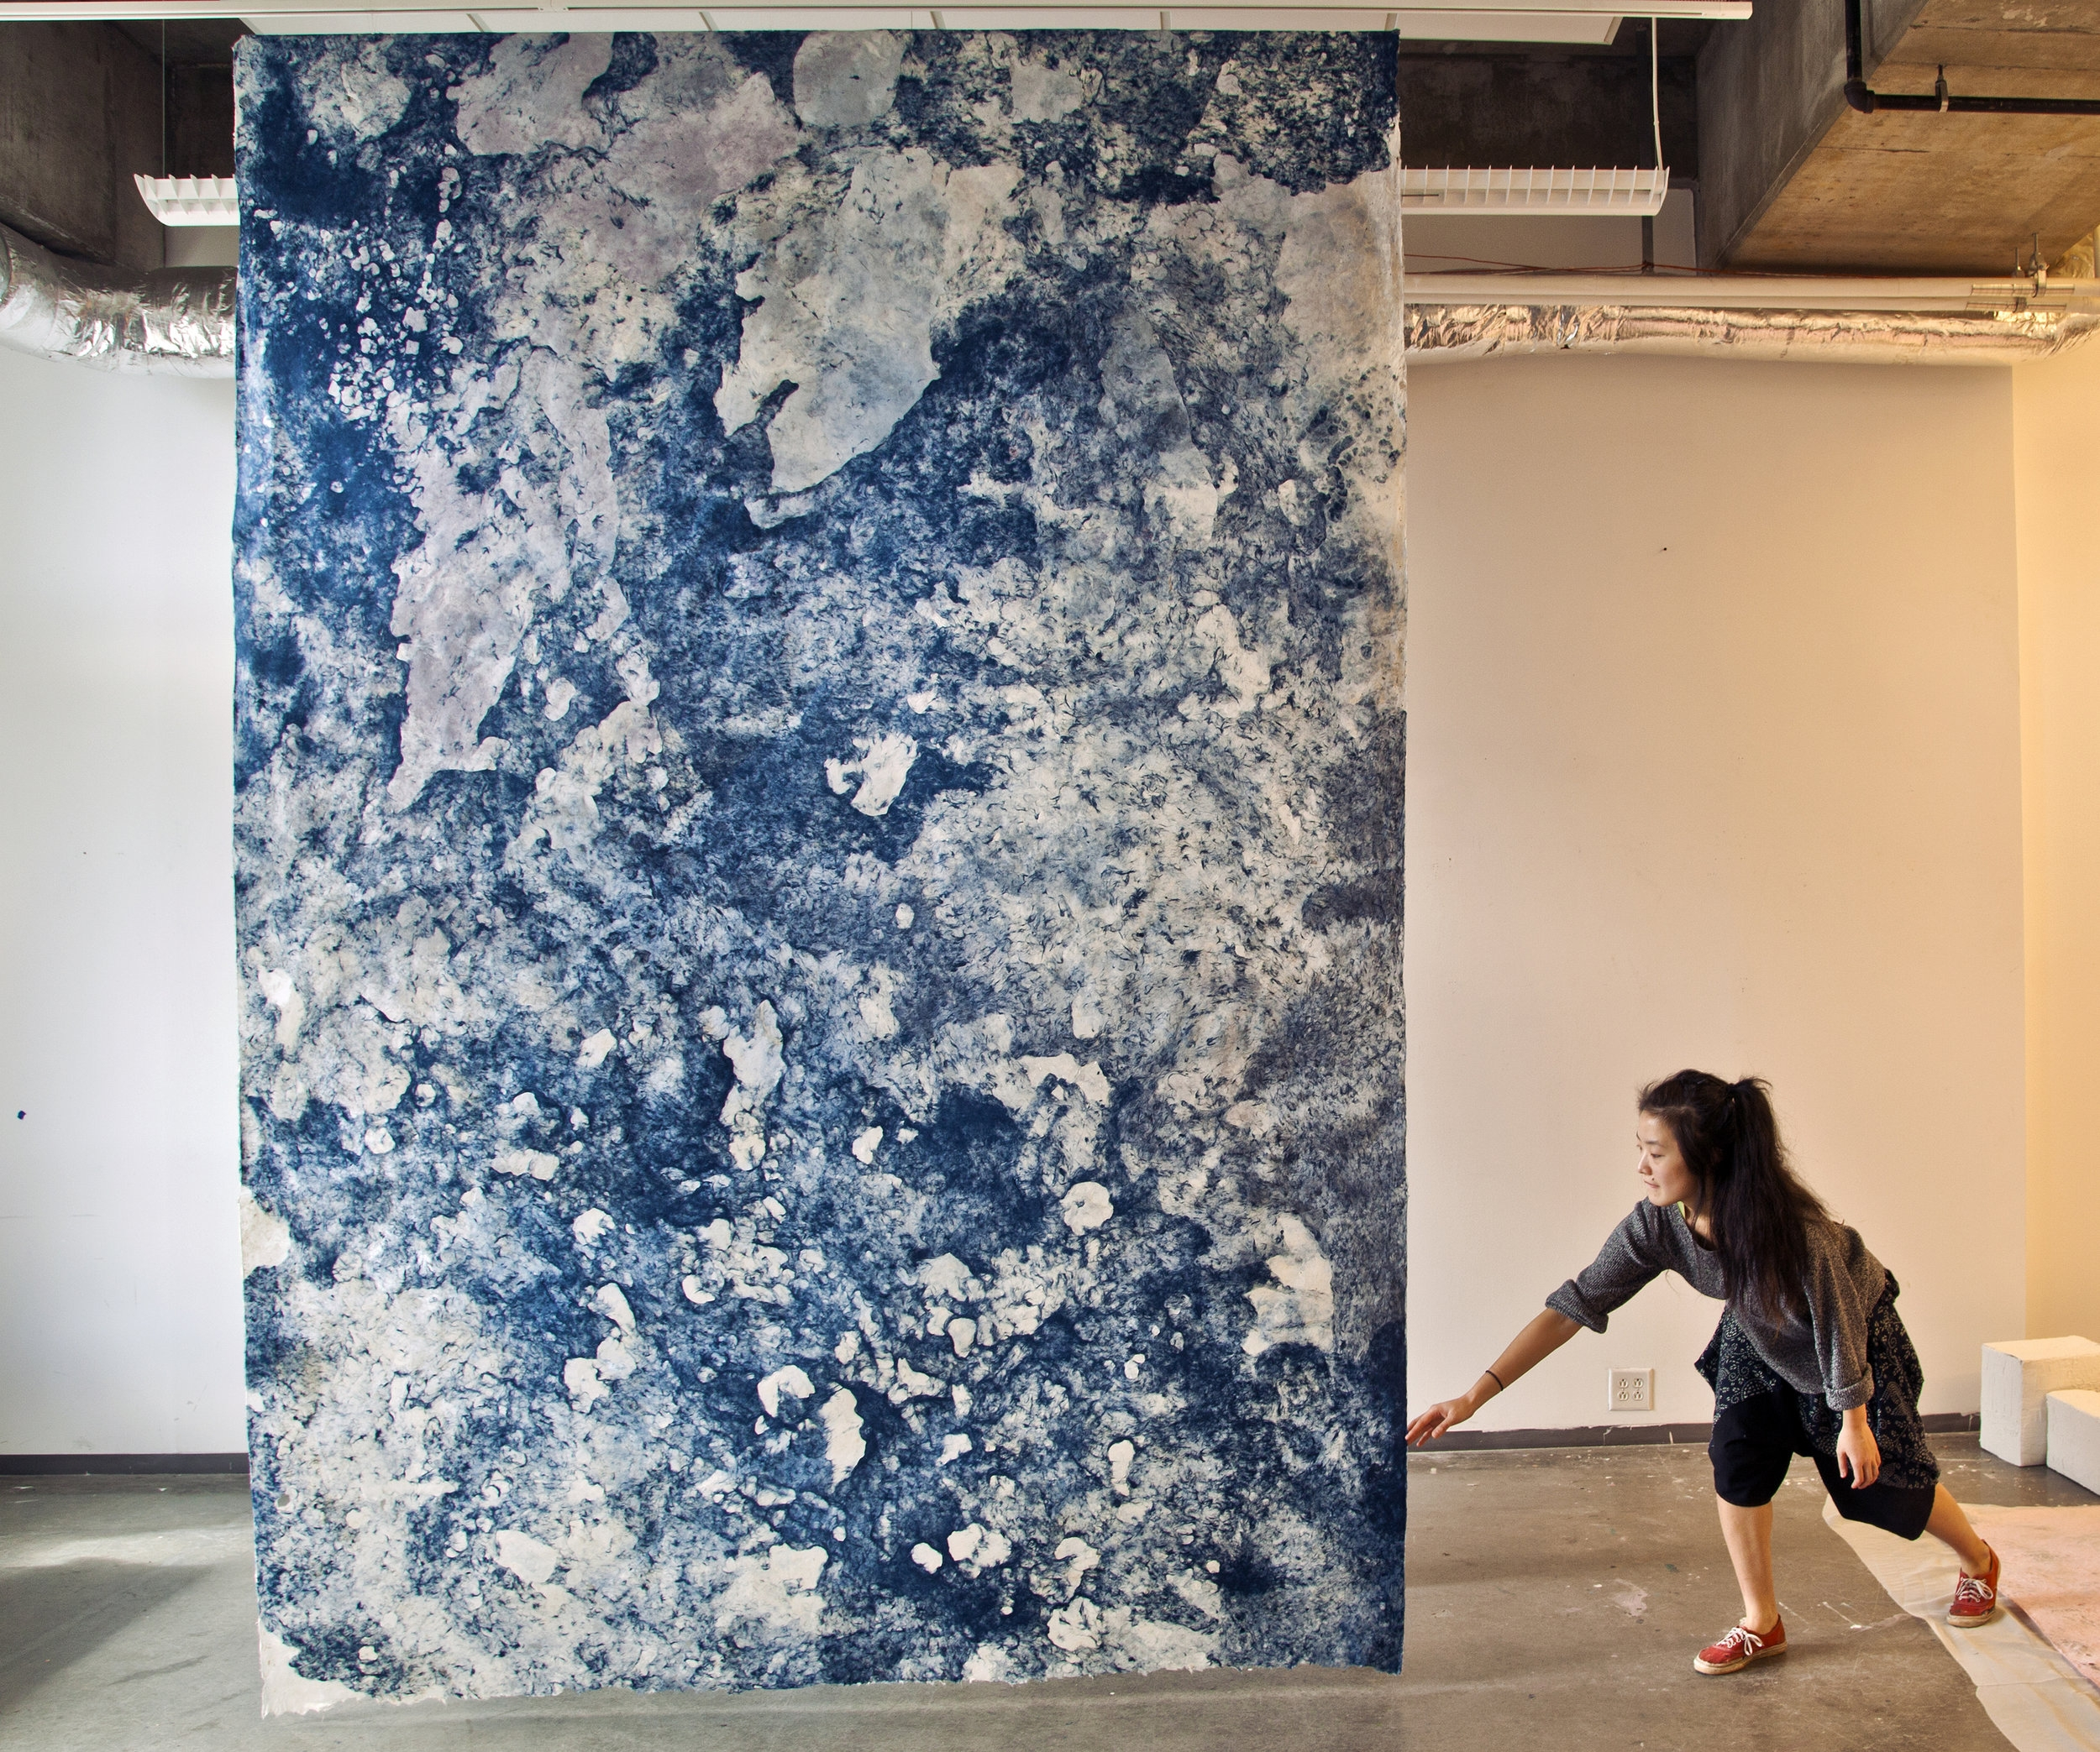
Hong Hong

Slide 8
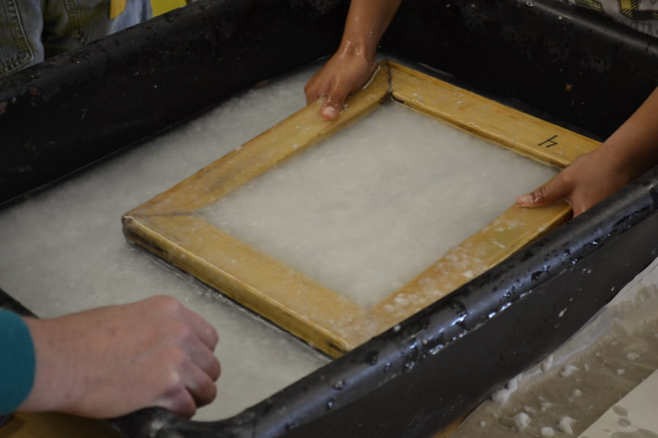
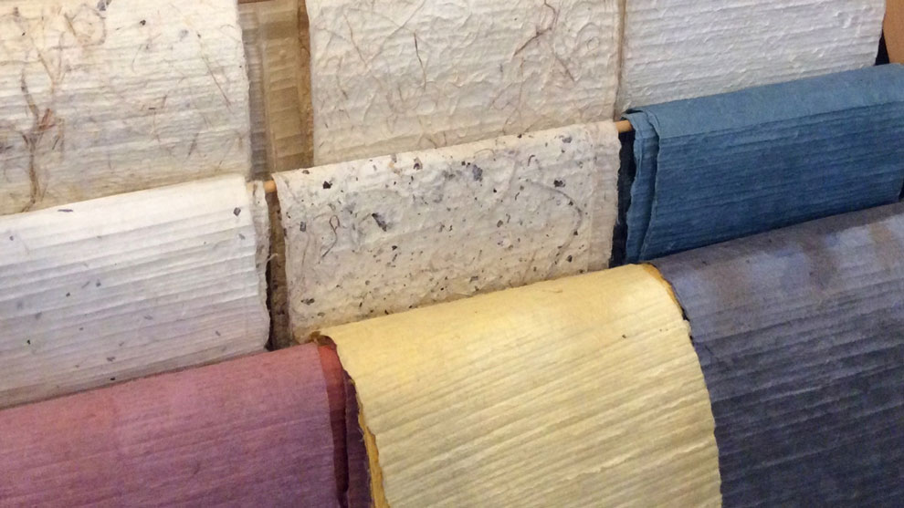
Traditional

Slide 9
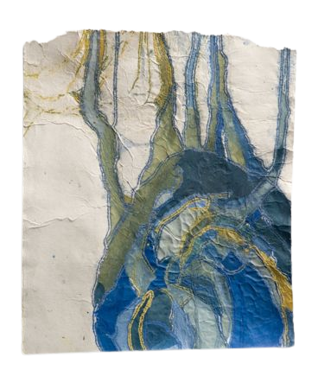
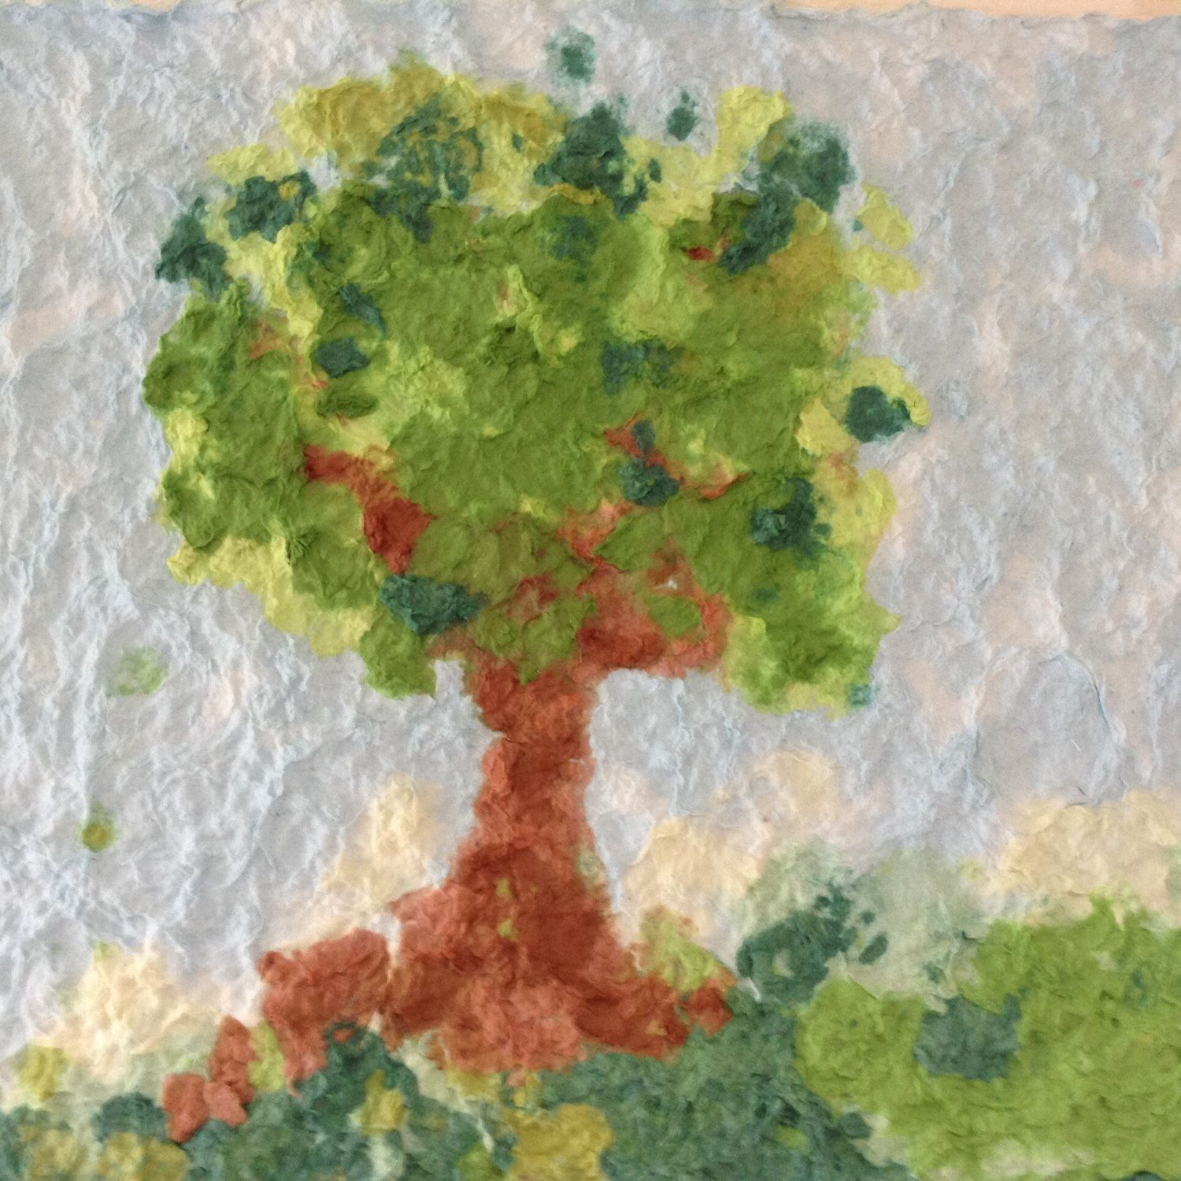
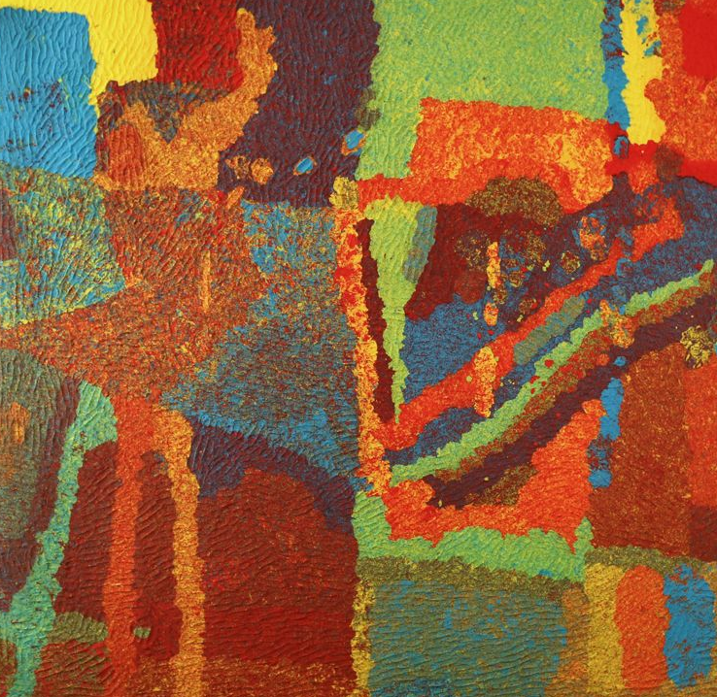
Modern

