Slide 1
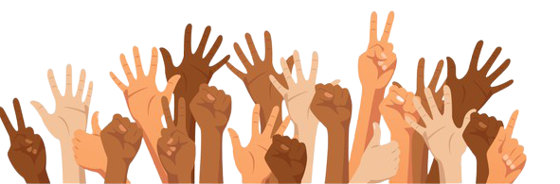
Identity

Slide 2

What is Identity?
Who you are, the way you think about yourself, the way you are viewed by the world and the characteristics that define you.
Identity is anything and everything about a person that makes them who they are.
  Race
  Gender
  Cultural background
  Personality
  Nationality
  Beliefs
  Interests

Slide 3
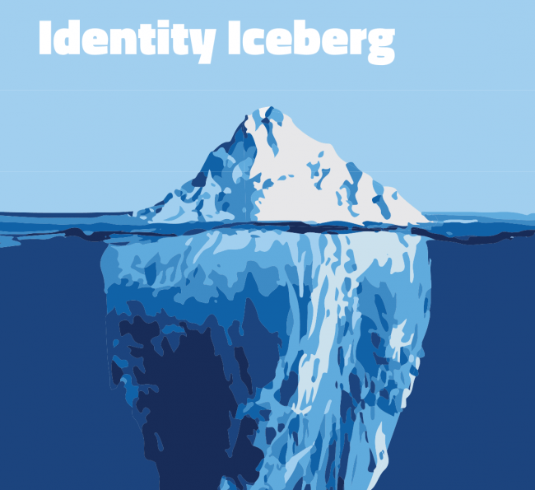
Only about 13 percent of an iceberg is visible above the water. The remaining part is submerged underwater, and you can’t see it until you move closer or go beneath the surface.
Similarly, only a small percentage of a person’s identity is visible at first glance. It takes getting to know them to learn and understand all of the the aspects that make up a person’s identity.
13%

Slide 4
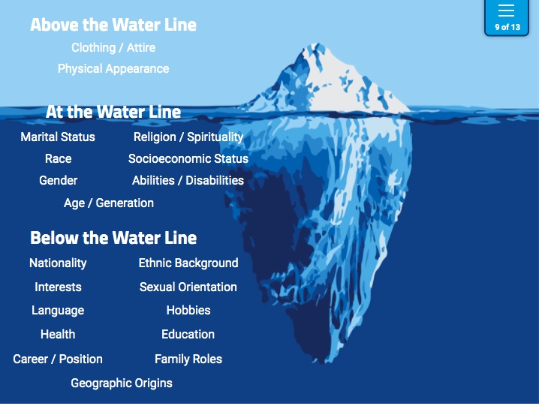
The parts of our identity that are above the waterline are the information people get jus but looking at us. “First glance assumptions”

Slide 5
The parts of our identity that we present to others. Think about how you present yourself at school or on social media. “Instagram Bio”

Slide 6
These are the aspects of our identity that we may only choose to share with people that we are close with or comfortable with. It is sometimes easy to make assumptions, but you don’t always know these parts of a person’s identity until you get to know them. “Autobiography”

Slide 7
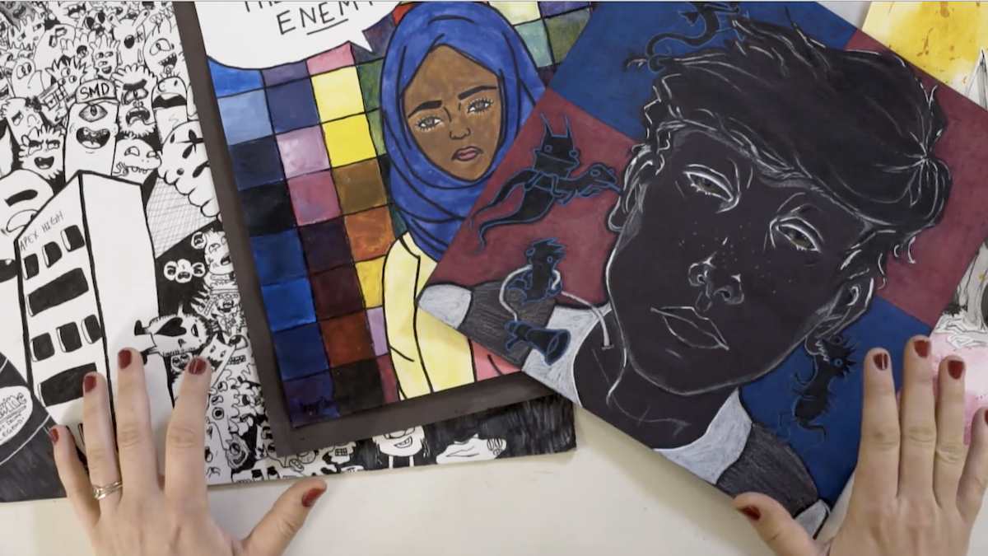
How do Artists use their work to portray their identity?

Slide 8
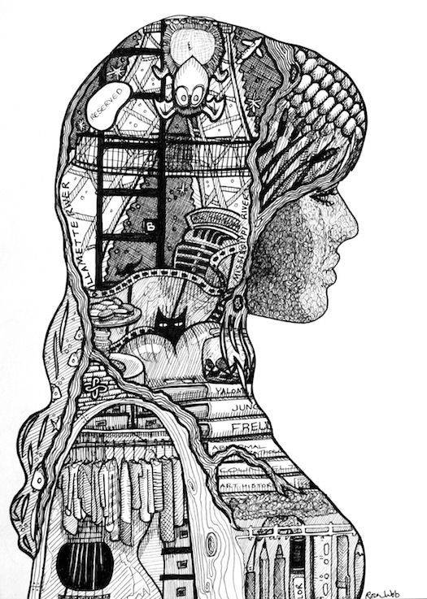
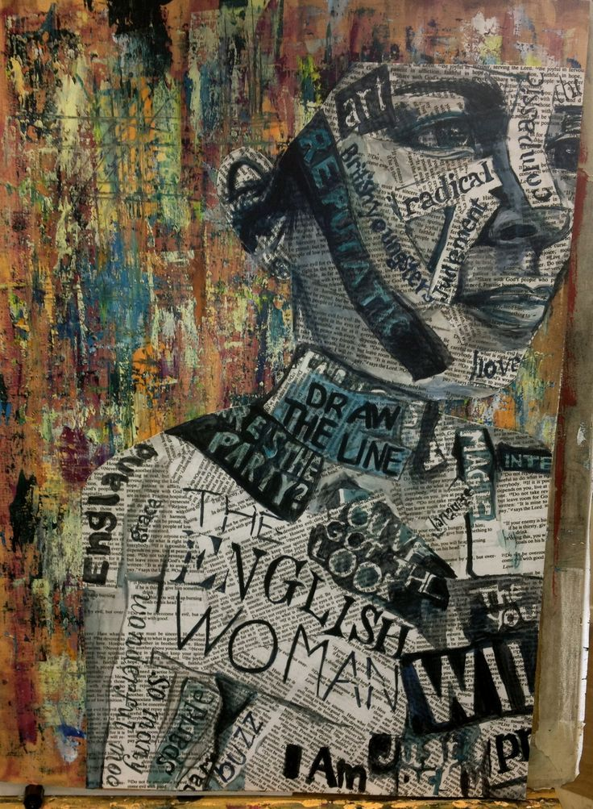

Slide 9
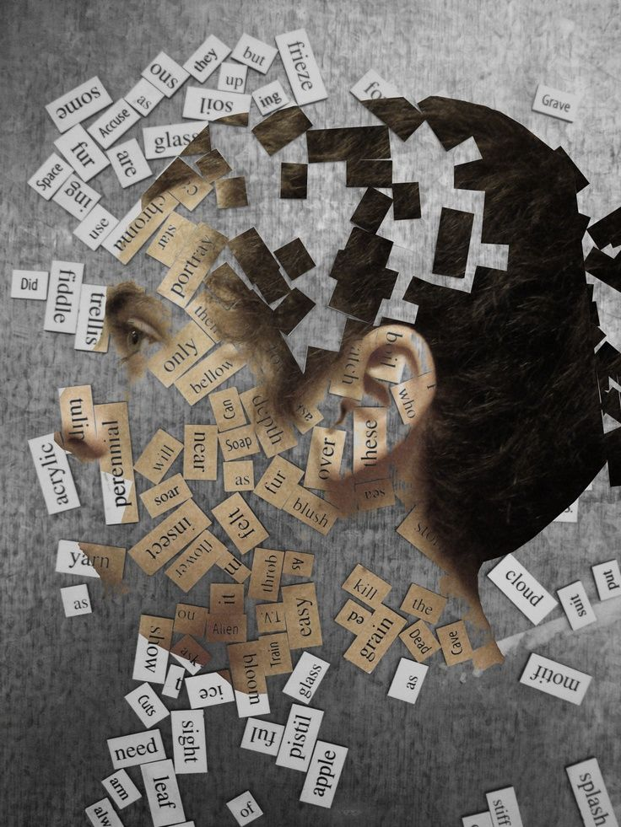


Slide 10
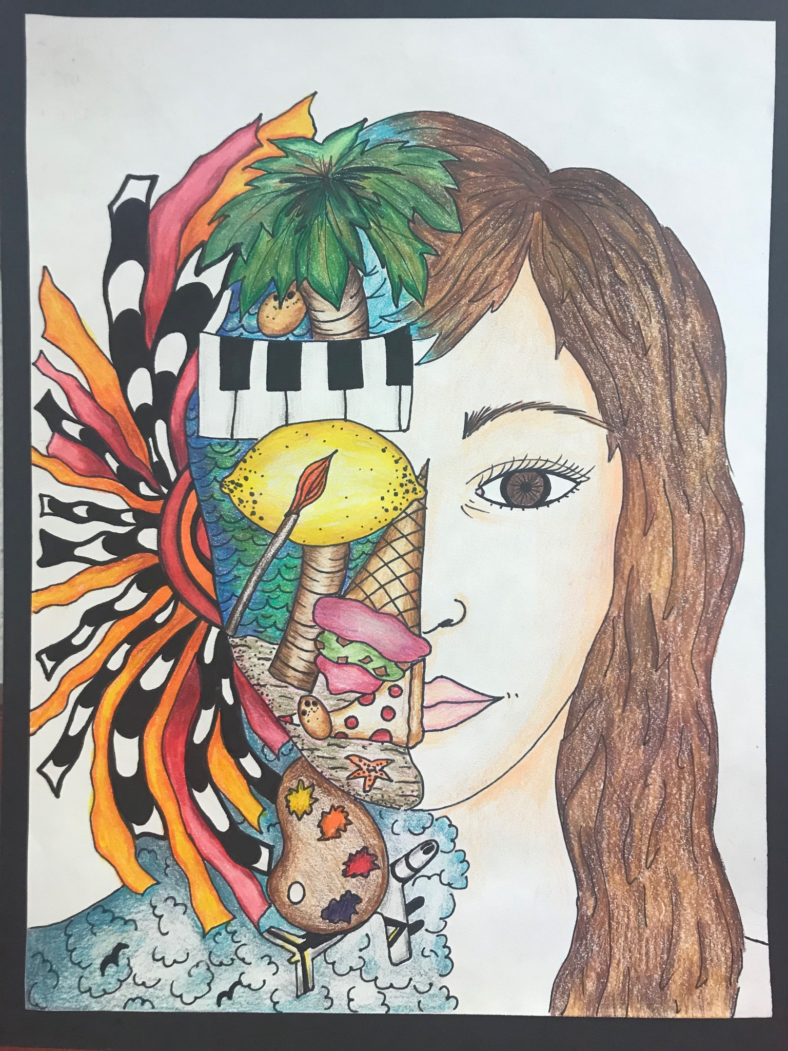
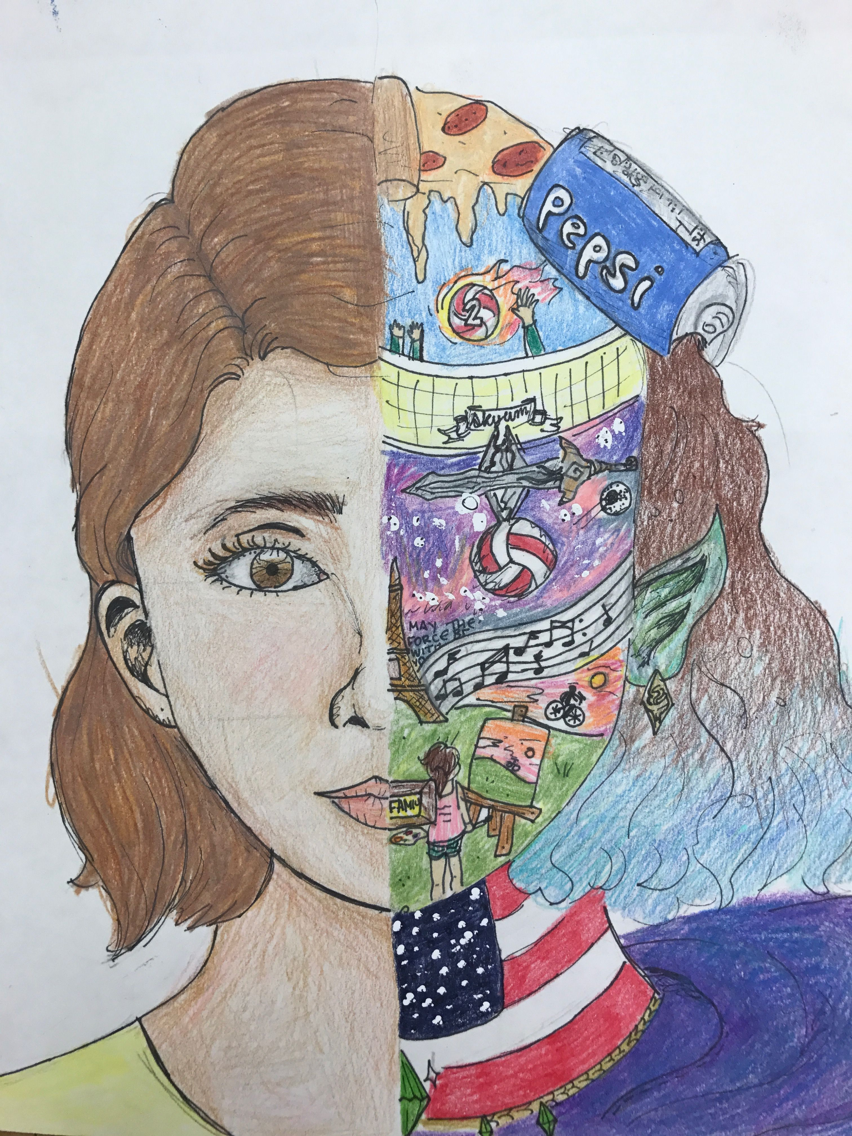

Slide 11
